Slide 1

Property Registration System
Presented By:
Ameya Ambike
Partha Gautam
Rithik Rai
Tejas Rajebhosale
Shubham Srivastava
Varsha Satpathy
Notes:
© Copyright PresentationGO.com – The free PowerPoint and Google Slides template library

Slide 2

Introduction
The current property registration system is riddled with inconsistencies and inefficiencies, resulting in a lack of protection for property records, with citizens bearing the brunt of the burden. Similarly, tens of thousands of others are facing such crisis.
With the help of Blockchain, all documents can be stored indefinitely, are easily accessible, and no one can ever doubt the authenticity of the data because they are constantly supplied into the system. As a result, no one can ever change it, and any participant can view the records at any moment. In fact, because of Blockchain's transparency, it's possible to follow changes made in property records.
Notes:
© Copyright PresentationGO.com – The free PowerPoint and Google Slides template library

Slide 3
General Description
Notes:
© Copyright PresentationGO.com – The free PowerPoint and Google Slides template library

Slide 4
Product Perspective
The focus of real estate technology has typically been on listings and connecting buyers and sellers. However, blockchain has the potential to bring new ways to trade real estate and to enable trading platforms and online markets to more thoroughly support real estate transactions.
The real estate ecosystem has traditionally included brokers, lawyers, and banks. However, blockchain has the potential to change their roles and involvement in real estate transactions. Listings, payments, and legal documents are all functions that new platforms could someday take over.
By eliminating intermediaries, buyers and sellers will get better value for their money because they will save on commissions and fees charged by these intermediaries. This also speeds up the process by eliminating the back-and-forth between these middlemen.
Notes:
© Copyright PresentationGO.com – The free PowerPoint and Google Slides template library

Slide 5
Objective
To create a Property Registration System that will help:
• To create a unified platform for marketplaces
• To eliminate the extra cost of intermediaries
• To increase the liquidity of real estate business
• Push the concept of fractional ownership
• Decentratization to improve trust and security
Notes:
© Copyright PresentationGO.com – The free PowerPoint and Google Slides template library

Slide 6



Tools used
•Python: It is an interpreted, object-oriented, high-level programming language used as a support for software developers, for build control and management, testing, and in many other ways
•Postman: It is an interactive and automatic tool for verifying the APIs of a project.
•Spyder: It is an open-source cross-platform IDE, written completely in Python.

Slide 7
Architecture
Notes:
© Copyright PresentationGO.com – The free PowerPoint and Google Slides template library

Slide 8
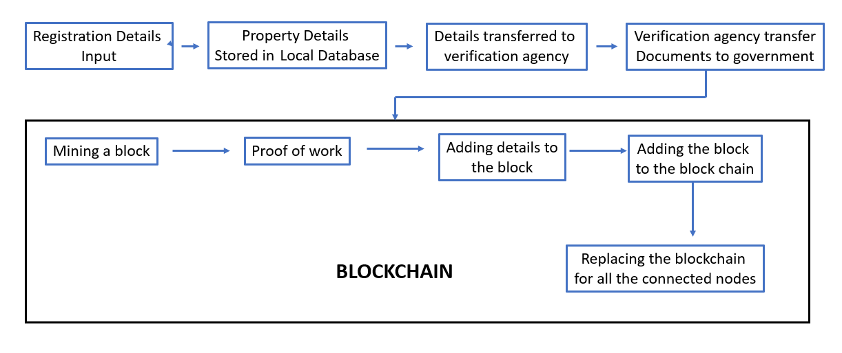
Program Flow Architecture
Notes:
© Copyright PresentationGO.com – The free PowerPoint and Google Slides template library

Slide 9
Architecture Description
1
Registration Details Input
Data transferred to verification agency
3
The first step is to input owner, buyer and property details to the Property Registration System portal. The customer use this portal when he/she buys a property from a land owner.
In this stage, the real estate agency transfers the documents to an external verification agency. The external verification agency will perform the physical verification of the owner, buyer, property details etc.
2
Storage in local database
4
Agency to the government
The uploaded details get stored in the local database. The real estate agency maintain these databases only for the temporary storage of the customer’s files.
Once the external verification agency completes the verification, they authenticate and certify the verification done and transfer the verified data to the government.
Notes:
© Copyright PresentationGO.com – The free PowerPoint and Google Slides template library

Slide 10
Architecture Description
Proof of Work
6
5
Mining a block
While mining a block, once the hashkey is generated, the hashkey is verified for the predetermined sequence. If the condition is satisfied, the proof of work is complete. If not, the hashkey is again generated.
Algorithm for Hashing: SHA – 512
SHA 512 has 128 characters as compared to SHA 256 with 64 characters. The reason for choosing SHA-512:
● It is faster than SHA-256 on 64-bit machines is that has 37.5% less rounds per byte (80 rounds operating on 128 byte blocks) compared to SHA- 256 (64 rounds operating on 64 byte blocks)
● It is more secure than SHA 256
It is the process of finding a nonce which satisfies the HASH restrictions. In this architecture, the government is assumed to be the one’s building and maintaining the blockchain. Once the verified data is received by the government, they mine a block with the requisites.
7
Adding data to block
Once the proof of work is completed successfully, the verified data are added to the block.
8
Adding to the blockchain
Once the block is created successfully, the block will be added by the government to the blockchain.
Notes:
© Copyright PresentationGO.com – The free PowerPoint and Google Slides template library

Slide 11
Broadcasting the updated blockchain
The updated blockchain is now being broadcast to all the nodes (real estate agencies) in the network. This is done by replacing the blockchain of all the nodes with the new blockchain along with the added block.
If an agency wants to get integrated to the blockchain, then an add node module is used to add the node to the blockchain network.

Slide 12
Now let the demo begin…
Notes:
© Copyright PresentationGO.com – The free PowerPoint and Google Slides template library

